Slide 1
Statistics Denmark
How to find the relevant tables in Statbank Denmark + basic search info

Slide 2
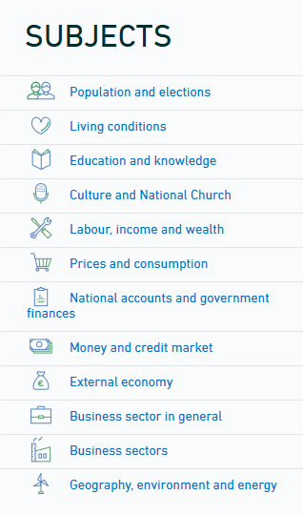
Start at the front page’s list of topics

Slide 3
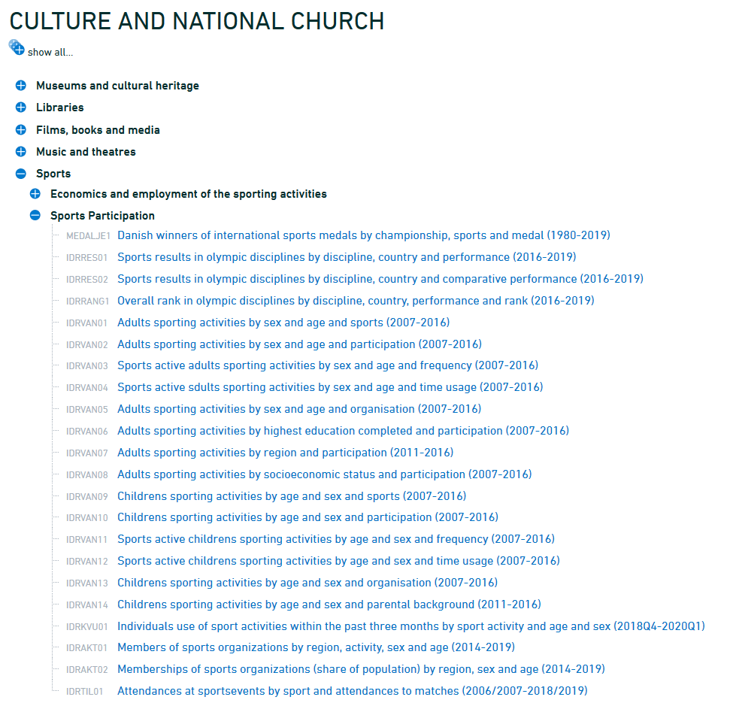
Read the table headers carefully – they are key information as to what kind of variables you can choose from within the specific table.
Note: The reason why data differs a lot from updated (2020) or quite old (2016) are due to the collection method.
Some data are integrated from registers – others are collected via field research.

Slide 4
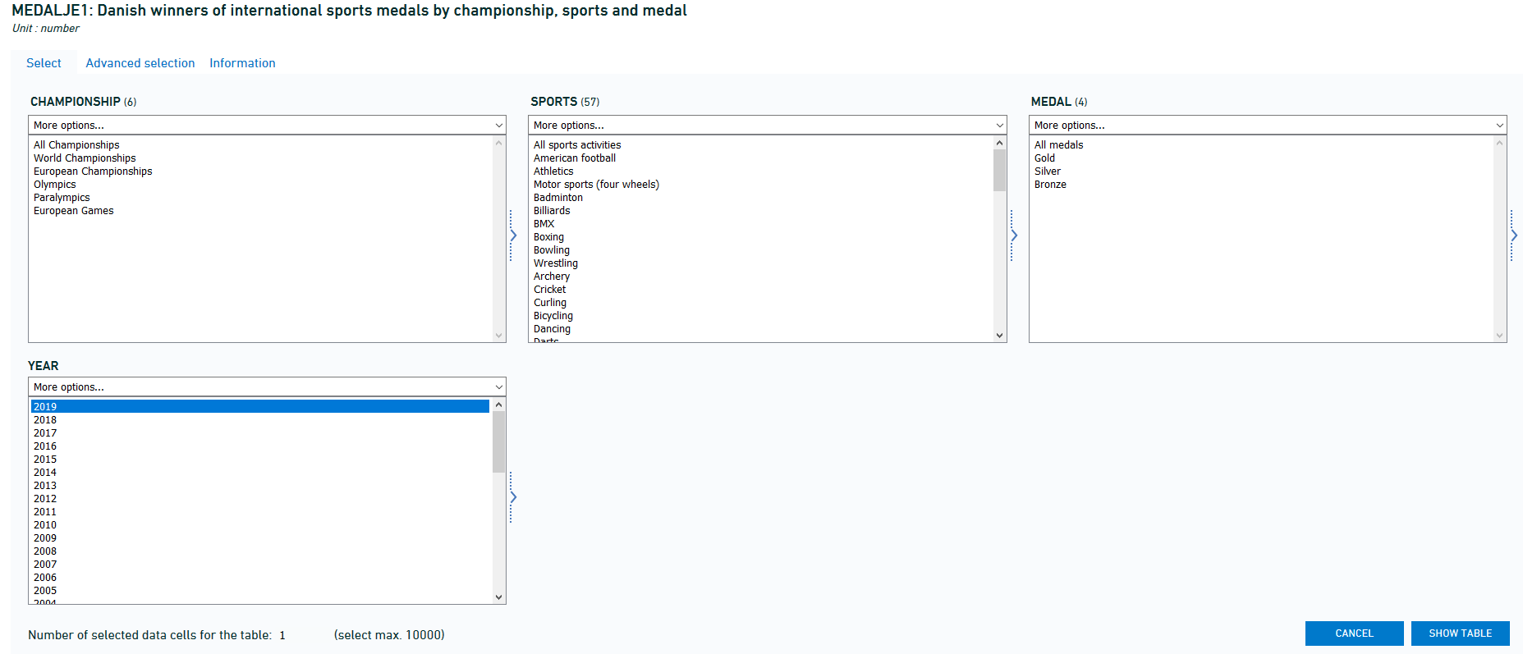
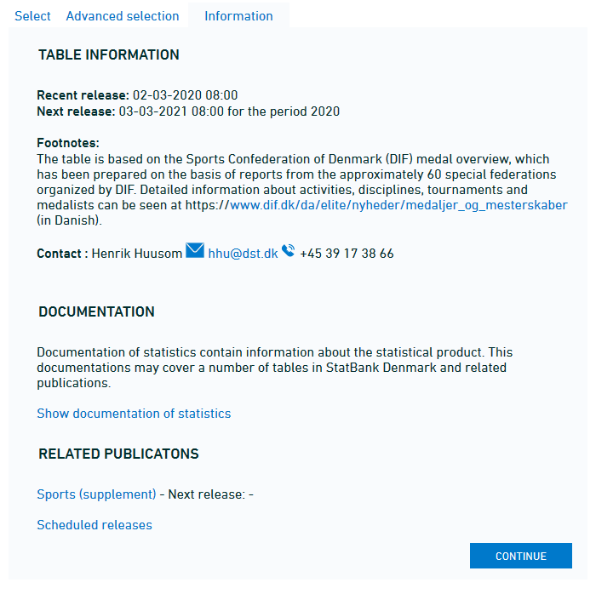
Choose one or more variables from each column.
Multiple variables are chosen by pressing control (PC) or command (Mac) key + click on variables.
In the ‘Information’ tab you can learn about source, methods and release dates – and who is the go-to person if you have questions.
In the bottom you’ll find links to relevant publications.

Slide 5
eaa-bibliotek@eaaa.dk 7228 6040
Do contact the library if you’re in trouble!

