Slide 1
Get started with ZOTERO

Slide 2
ZOTERO
Zotero is a free programme, that help keep track of both your research and your references.
Whole/partial download of data from sources
Organizes sources in sublibraries and with tags
Reference handling through Word and Google docs
Bibliography (literature list) with one click
Work in groups (share sources)
Online backup on Zotero.org
W

Slide 3
Well then, let’s get started!
Download Zotero (2 files) via https://www.zotero.org/
A library, to keep track of your sources (your research)
An extention for your browser. We recommend Firefox and Chrome, the extention for Safari is a little wonky (beta-version)

Slide 4
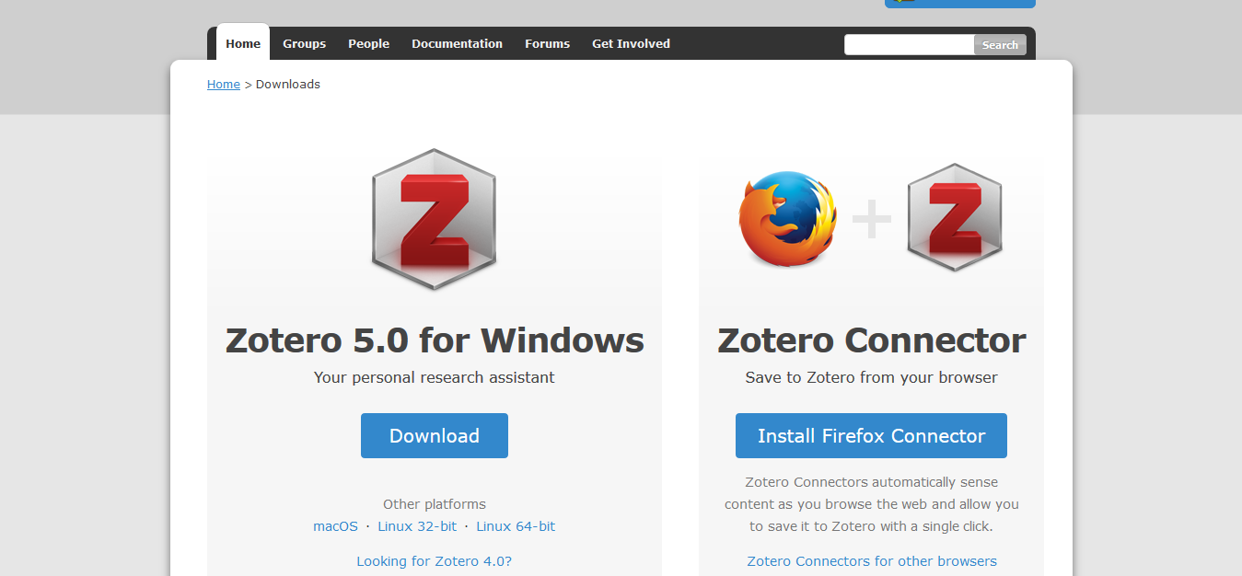
You HAVE TO download both Zotero 5.0 (library) and Zotero Connector (browser extention). I have a pc and use Firefox – your screen might look different if you have a mac or use another browser.

Slide 5
ZOTERO
On the plus side
Problems
Download data whole or partial from most sources
Organize sources in sublibraries and with tags
Handling references using Word and Google docs
Literature list with one click
Groupwork
Online backup on Zotero.org
I don’t have the right standard? (Anglia Ruskin Harvard)
I cannot find the Zotero-plug-in, in Word
I don’t have the browser extention
Double check if Zotero downloaded all data. ALWAYS ! EVERY SOURCE!

Slide 6
ZOTERO
Problemerne
I don’t have the right standard? (Anglia Ruskin Harvard)
I cannot find the Zotero-plug-in, in Word
I don’t have the browser extention
Double check if Zotero downloaded all data. ALWAYS ! EVERY SOURCE!
You’ll need to get all problems solved - we’ll help with that in the next slides – problem for problem!

Slide 7
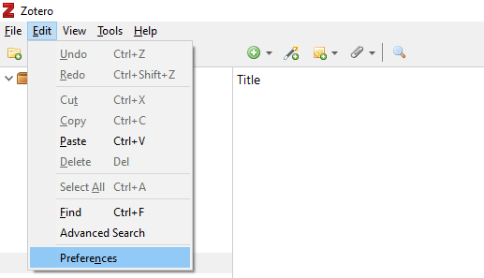
A
Choose ‘Edit’ > ‘Preferences’
Do you work on Mac?
Find ‘Preferences’ in the ZOTERO menu

Slide 8
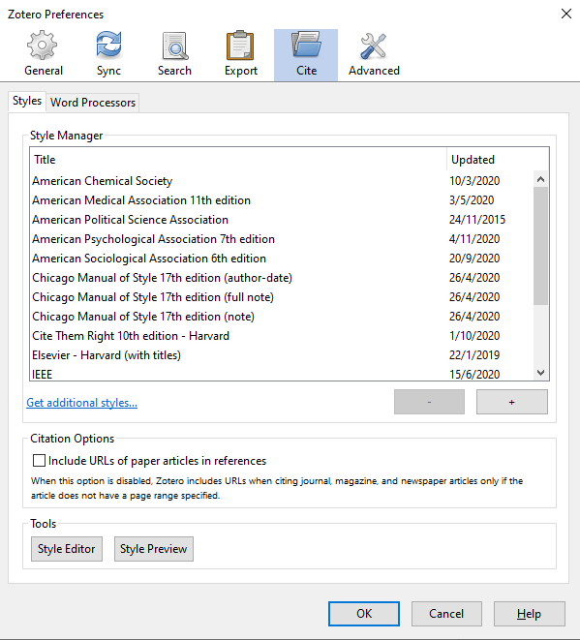
A
Choose ‘Cite’ in ‘Preferences’

Slide 9
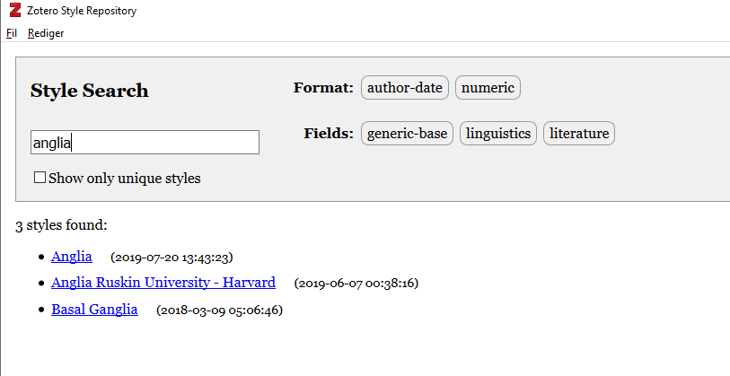
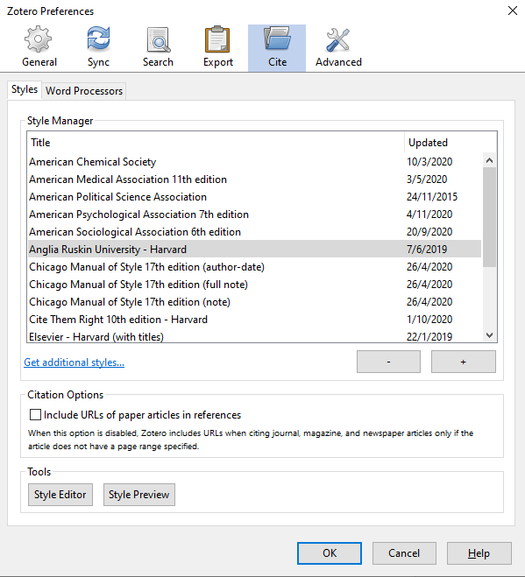
B
C

Slide 10
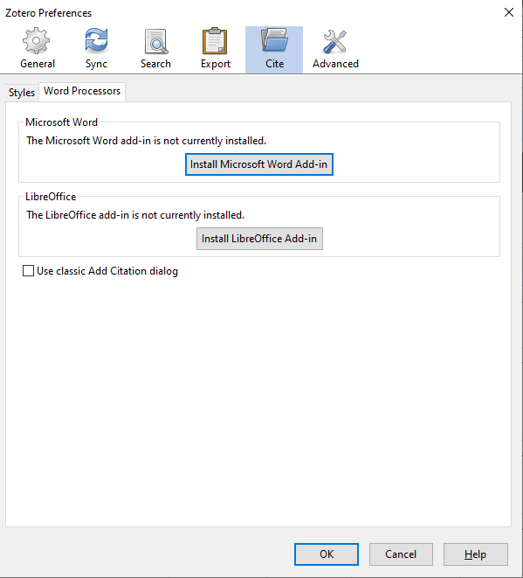
A: Shut down Word entirely!
B: Open the preferences in Zotero:
C: Fire up Word again –
Check the menu: ‘Zotero’

Slide 11
The icon for the Connector is locted top right in the browser and looks different depending on the media type, ie:
Do you use the browser (Chrome or Firefox) that you downloaded Zotero for (slide 4)?

Slide 12
Zotero downloads ‘meta data’ - information on sources ie:
Titles (on web pages, articles, books, blogs, magazines etc)
Author (the sender – individuals or organizations)
Medie types (web site, pdf, book, article, report, statistical table)
Date for publishing (a year or a full date)
Access date (online sources only)
Online sources don’t always have full meta data. Check our source management guide – then you’ll know which meta data to add to the Zotero registration: https://library.baaa.dk/media/3cspqzhe/source-management-harvard.pdf

Slide 13
HEEEEEEEEELP! https://www.zotero.org/support https://kub.kb.dk/zotero Or drop by the library …

