Slide 1
Statistics Denmark
How to find the relevant publication at www.DST.dk

Slide 2
This is a guide to the Danish page – why’s that????
The English page has some English language publications – but not a lot. And mostly quite general.
The Danish original has a lot of invaluable Danish publications.
Use Google translate!

Slide 3
Start at the front page’s list of topics
Hint: If you’d like to find an analysis that matches your data from the Statbank Denmark, the correlating publication is saved under the same topic.

Slide 4
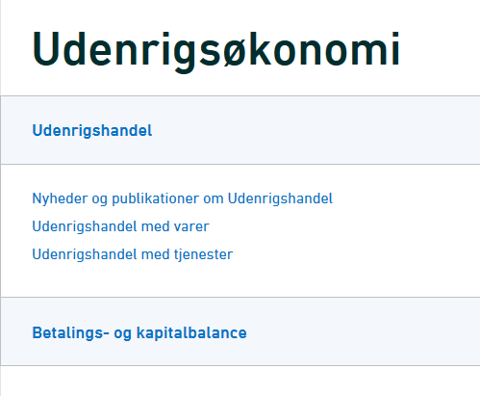
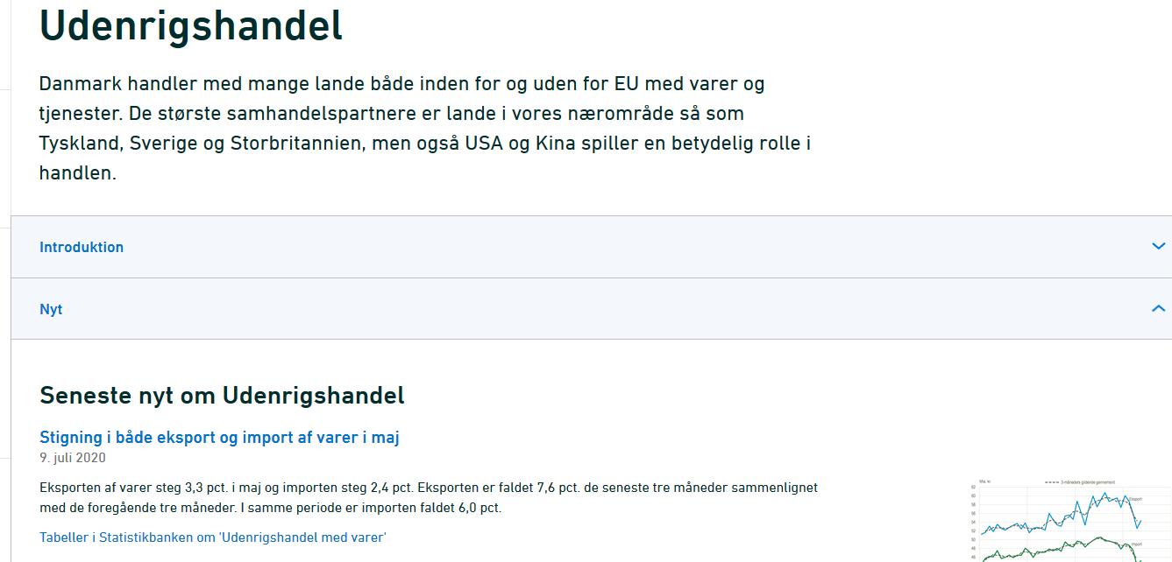
The main topic is organized in subtopics, always initiated with ‘Nyheder of publikationer’ (News and publications).
When linking to the publications, the field ‘Nyt’ is always expanded. In the next picture, I’ve collapsed the headlines to see the big picture (press the arrow right to expand/collapse).

Slide 5
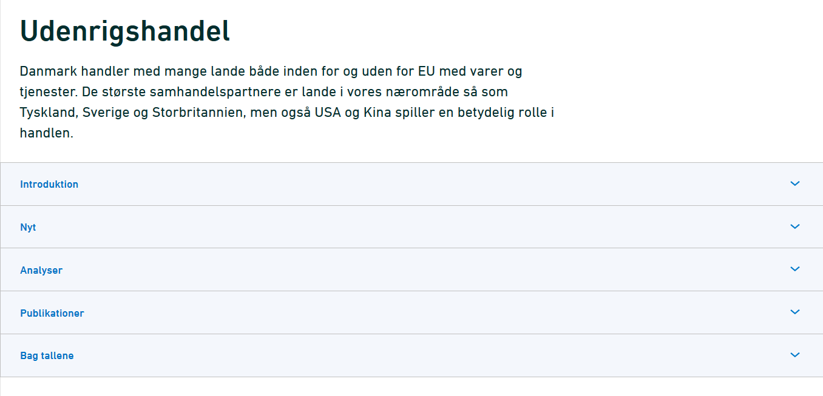
‘Introduktion’= Gives an introduction to the topic – and a vocabulary
‘Nyt’ = News. An online magazine featuring short articles about new statistics.
‘Analyser’ = Analysis, which focus on connections across statistical topics, for the purpose of contributing to facts and new knowledge.
‘Publikationer’ = Publications are e-books, free or for sale
‘Bag tallene’ = articles on new statistics, targeted the media

Slide 6
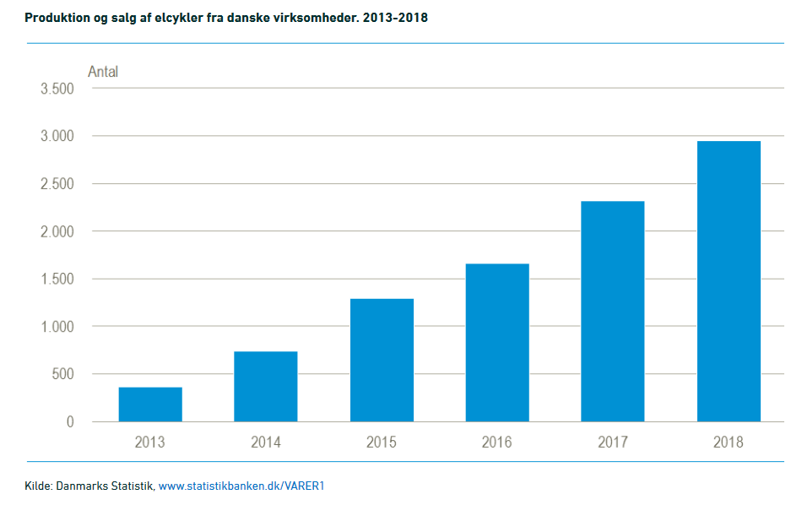
All publications refer to specific or relevant tabels, used in-text.
Being online, they’re only a click away.

Slide 7
eaa-bibliotek@eaaa.dk 7228 6040
Do contact the library if you’re in trouble!

