Slide 1
PASSPORT – find analysis

Slide 2
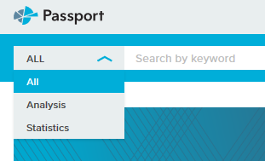
Find analysis
To get easy access, choose ”Analysis” in the search field, write your subject and your country [e.g. Wine Denmark]
When you click ”GO” these possibilities are shown really fast, and if you don’t choose then the screen changes (see next slide)

Slide 3
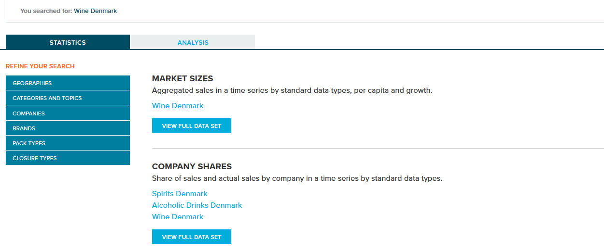
When you have searched, you’ll get both statistics AND analysis:

Slide 4
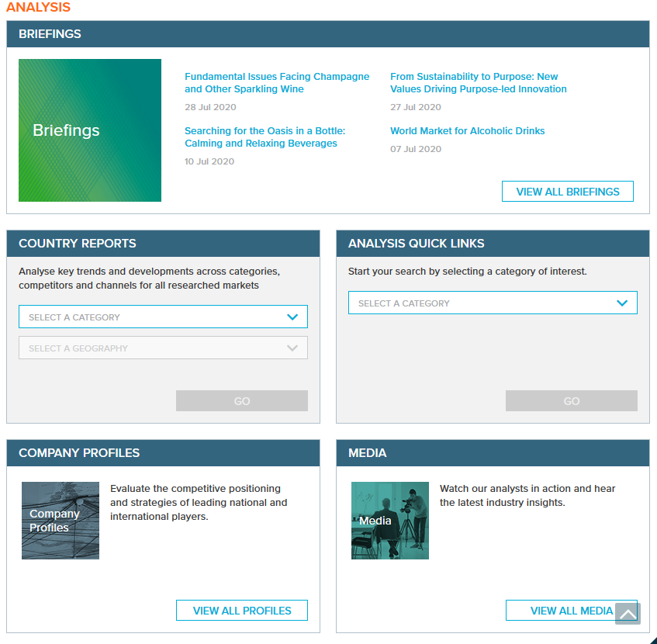
Via the top menu you can also find analysis. Choose a category (e.g. ”Industries” and then choose a subject (e.g. ”Alchoholic drinks”)
It’s not a problem to use the search field, but it is contingent upon the fact that you know the vocabulary in Passport. If not, you might get a lot of empty searches.
We recommend everyone to use ”Search full tree”, because you can see all subjects in Passport there

Slide 5
eaa-bibliotek@eaaa.dk 7228 6040
Contact the library, if you are in trouble (Passport wise ;-)

